Slide 1

BIBOO
Shenzhen Biboo New Energy Technology Co., Ltd.
POWER YOUR OUTDOOR LIFE
Portable Power Stations | Solar Generators | Energy Solutions

Slide 2

CONTENTS
01
02
03
ABOUT BIBOO
Illuminate the outdoor life and explore the infinite charm of the symbiosis between nature and technology.
CORE TECHNOLOGY
The perfect fusion of a powerful heart and a smart brain defines a new benchmark for energy.
PRODUCT MATRIX
With diverse scenario coverage, there's always a product that perfectly matches your needs.
04
05
APPLICATIONS
From mountain camping to emergency rescue, boundless power unlocks endless possibilities for your life and work.
ECOSYSTEM
Build an open and shared energy ecosystem network that connects hardware, software, and services to expand your energy boundaries.

Slide 3
01
ABOUT BIBOO
Brighten Your Outdoor Life

Slide 4



About BIBOO: Our Story and Vision
At BIBOO, we are not only explorers of energy technology, but also staunch advocates of the outdoor lifestyle. We understand that reliable, clean electricity is key to a fulfilling outdoor experience, whether you're an explorer venturing into the wilderness or a family enjoying a weekend camping trip. We firmly believe that electricity should not be a constraint on exploring the world, but rather a source of confidence for free travel.
Deep insight born from real pain points: Traditional fuel generators are noisy and disturb residents, pollute the environment, and are cumbersome to operate, while ordinary power banks struggle to meet the power demands of high-wattage outdoor equipment. By recognizing this gap in the outdoor energy market, BIBOO, with green innovation at its core, offers users a better solution.
Our vision
Our mission
Become the preferred energy solution provider for the global outdoor lifestyle, enabling everyone to freely, safely, and worry-free explore and enjoy the beauty of the outdoor world.
Through innovative green energy technology, break the boundaries of electricity, empower every journey users take, make outdoor “power outages” a thing of the past, and provide stable and reliable energy support for every exploration.

Slide 5



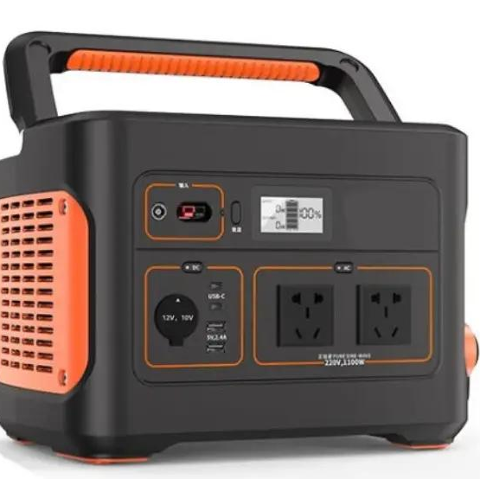


Globally Trusted, Quality Certified
Since its inception, BIBOO's products have been sold to numerous countries and regions in Europe and America, serving millions of outdoor enthusiasts, families, and professionals. We deeply understand that safety is the cornerstone of all outdoor experiences, and all our products are designed and manufactured in strict accordance with international safety standards, passing a series of stringent certifications to ensure your safety every time you use them.
Certification
EU authoritative standards
Certification
US Electromagnetic Safety
Compliant with the LVD (Low Voltage Directive) and EMC (Electromagnetic Compatibility Directive), ensuring product compliance and safety in the EU market.
It complies with Federal Communications Commission standards, strictly controls electromagnetic radiation, and ensures user health and device compatibility during use.
Global sales network
Deeply rooted in the outdoor equipment industry, we have established a comprehensive sales system covering Europe, North America, Asia Pacific, and other regions, making high-quality products readily available.
UL 2743
Battery energy storage safety
UN38.3
International Transport Compliance
Strict safety controls throughout the entire process
From raw material selection and product research and development to manufacturing and logistics, every step adheres to the highest international safety standards to ensure worry-free use for users.
The stringent safety standards for battery energy storage systems, covering electrical, mechanical, and fire safety, are the core safety certifications for outdoor power supplies.
The International Air Transport Association's mandatory safety standards for the transport of lithium batteries ensure the absolute safety of the products during sea and air transport.

Slide 6
02
CORE TECHNOLOGY
The Powerful Heart, A Smart Brain

Slide 7





Smart BMS: Protecting Every Charge
Every outdoor power bank is equipped with a powerful "smart brain"—the Smart BMS (Battery Management System). As the core component ensuring battery safety, extending lifespan, and ensuring stable output, the latest iteration of the intelligent BMS system provides multiple safety protections for the battery through high-precision algorithms and real-time all-dimensional monitoring, ensuring worry-free power usage every time.
Multiple security protections
Building a comprehensive safety barrier covering all scenarios of charging, discharging, and idleness, providing solid protection for outdoor power use.
Real-time cell monitoring
Real-time monitoring of voltage, current, and temperature data for each battery cell allows for control over battery operation from the source, eliminating potential risks.
Working protection
Multiple protections against overcharge, over-discharge, over-temperature, short circuit, and over-temperature.
Circuit protection
Overcurrent, overvoltage/undervoltage, and reverse connection protection
Revitalize Battery Lifebattery life.
Actively eliminating voltage differences between battery cells extends the overall cycle life of the battery, making the most of every unit of electricity.
From algorithmic monitoring to physical protection, Smart BMS makes safety a standard feature of outdoor power supplies, safeguarding your exploration journey.

Slide 8
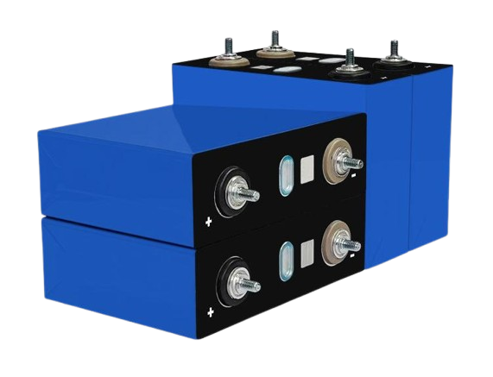



LiFePO₄ Battery:
Synonymous With Safety And Longevity
All products are equipped with lithium iron phosphate (LiFePO₄) batteries, which have achieved a comprehensive breakthrough in safety, cycle life and wide temperature adaptability compared with traditional ternary lithium batteries, redefining the standard of energy storage safety.
Ultimate security protection
Longer cycle life
With a stable chemical structure, it eliminates the risk of fire and explosion at the source, making it safer to use.
It supports over 2,500 deep charge-discharge cycles, and the battery capacity can still be maintained at over 80%.
Excellent wide temperature range
It uses lithium iron phosphate cells, with a stable chemical structure to build the energy core, providing a solid guarantee for outdoor power supply.
Operating temperature range: 14 to 104℉ (-10 to 40℃), with approximately 80% battery retention in low-temperature environments, and storage temperature range: 32 to 104°F (0 to 40°C), adaptable to various extreme climates.

Slide 9



Turbo-Charge: Say Goodbye to the Long Wait
We understand that "waiting" is one of the biggest pain points of outdoor power use. To address this, BIBOO developed Turbo-Charge fast charging technology. With a built-in high-performance charging module and intelligent algorithms, our flagship model can be charged from 0 to 100% in just about 1.5 to 1.8 hours, allowing your power supply to quickly "fully recover" after a short rest.
1.5h
Market-leading charging speed
With a built-in high-performance charging module, charging efficiency is increased several times, significantly reducing the charging time of traditional outdoor power station and saving you valuable time.
0-100% Fast charging
The flagship model features exclusive Turbo-Charge technology, eliminating the anxiety of waiting for power when outdoors.
Intelligent temperature control for safe charging
It monitors the core temperature of the battery in real time and intelligently and dynamically adjusts the charging power to ensure battery safety, stability and longevity while guaranteeing fast charging.
Flexible energy replenishment methods
It supports multiple methods of rapid power replenishment, including mains power, car cigarette lighters, and solar panels, making it easy to obtain electricity whether at home, driving, or camping in the wild.
Start

Slide 10
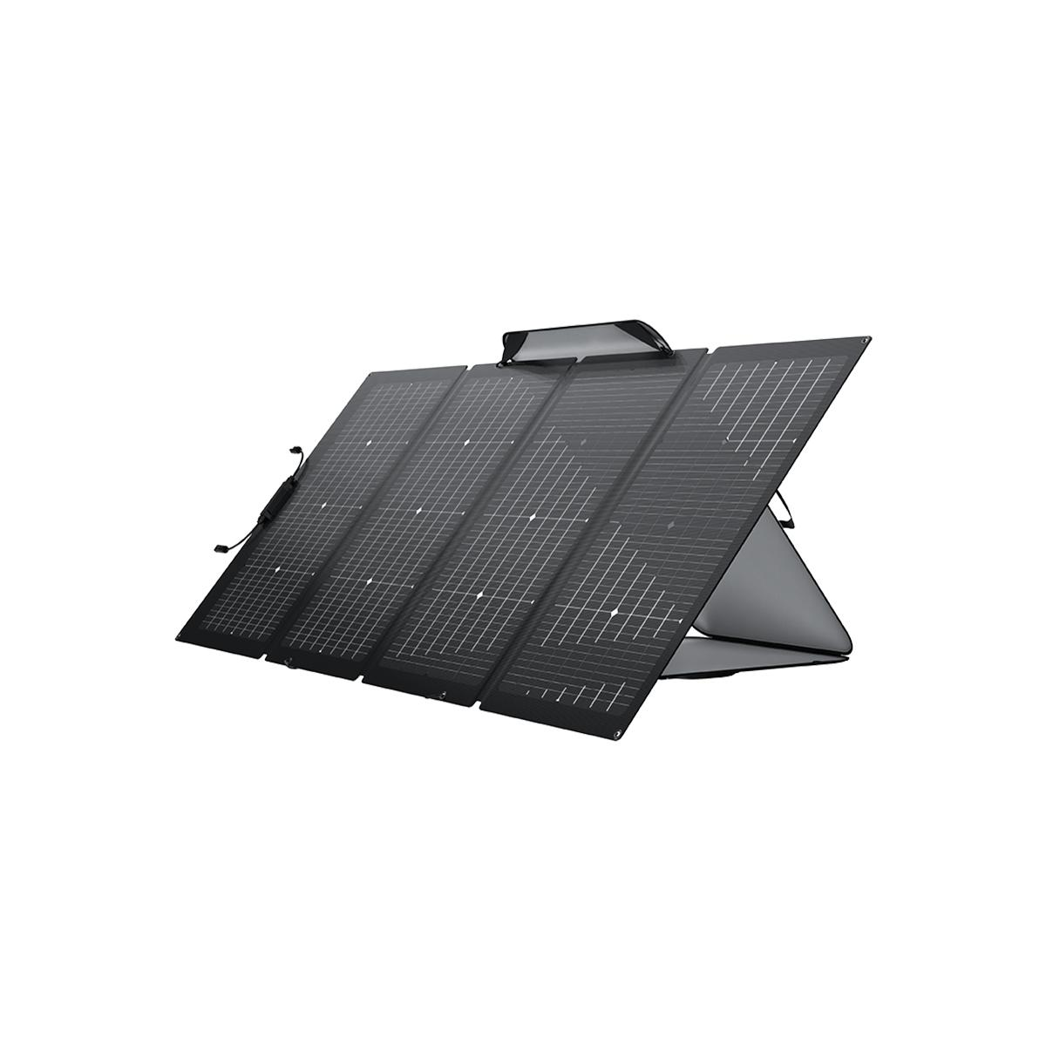



MPPT Solar Charging:
Efficiently Embracing Green Energy
Power station incorporate a high-efficiency MPPT (Maximum Power Point Tracking) solar charge controller. Compared to ordinary PWM controllers, MPPT technology can track the maximum power point of the solar panel in real time under different light intensities and temperatures, improving solar charging efficiency by up to 30%, ensuring that every ray of sunlight is converted into usable clean electricity.
Faster charging speed
Under the same lighting conditions, the system can absorb more solar energy, significantly shorten charging time, and make energy replenishment more efficient.
Wider adaptability
It can effectively capture solar energy even in low-light conditions such as early morning, evening, or cloudy weather.
Matching system
It is compatible with most solar panels of different specifications on the market.
High-efficiency portable solar panels designed specifically for outdoor use, compatible with MPPT controllers, bring green energy to your doorstep.

Slide 11





Pure Sine Wave Output:
Protecting Your Precision Equipment
BIBOO power station output a pure sine wave, with a waveform identical to that of household AC power. This means it can safely and stably drive various precision electrical appliances, such as laptops, projectors, cameras, and stereos, avoiding equipment damage, noise, or performance degradation caused by impure waveforms.
Pure Sine Wave (used by BIBOO)
The waveform is smooth and continuous, completely consistent with household AC power. The output power is pure and free of impurities, providing the safest operating environment for precision equipment and eliminating abnormal noise and hardware damage.
Highly Compatible
Perfectly compatible with laptops, cameras, projectors, and nearly all types of electrical devices. Just plug and play.
Runs Stably
Provides smooth power for motor-driven equipment, effectively extending the equipment's service life.
Protect Equipment
Eliminate harmonic interference to avoid damaging sensitive ec such as pc and audio equipment.
Modified Sine Wave
(standard portable power station)
The waveform is stair-step shaped and contains a large amount of harmonic interference. It is only suitable for simple devices such as light bulbs and resistive loads, and can easily cause motors to stall, precision instruments to crash, or even suffer permanent damage.
Whether working remotely or using power outdoors, BIBOO's pure sine wave output is always a reliable guarantee for protecting your valuable electronic devices.

Slide 12
03
PRODUCT MATRIX
There's Always A Product That Suits You.

Slide 13
Full Product Overview
300W Series
Model: AL300 / AL300W
Key features: Extremely portable, multiple interfaces to meet personal travel and daily charging needs.
600W Series
Model: AL600
Key features: Pure sine wave, powerful output, suitable for home camping and more.
1200W Series
Model: AL1200 / AL1200W
Key features: Powerful performance, supports fast charging, making it a mainstay for road trips and family emergencies.
2400W Series
Model: AL2400 / AL2400W
Key features: Ultra-high power, massive battery capacity, meeting the needs of RVs and professional outdoor operations.

Slide 14
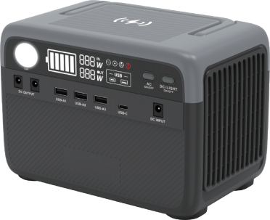
300W Series:
Lightweight And Portable, Charge Anytime, Anywhere.
Series Positioning: Designed specifically for personal outdoor travel, short trips, and everyday digital device charging. Extremely lightweight and easy to carry, it's the "energy cube" in your backpack.
AL300 / AL300W
Capacity: 230Wh
Rated Power: 300W (Peak 600W)
Weight: ≈3kg
Features: Pure sine wave, supports PD 60W bidirectional fast charging, and has stronger compatibility.

Slide 15
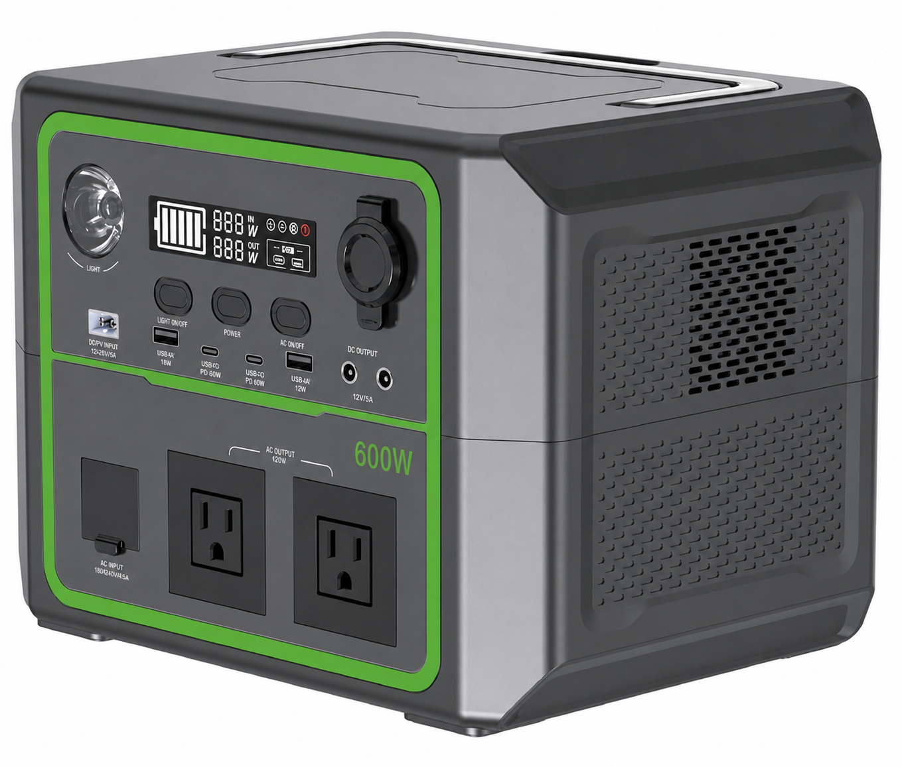
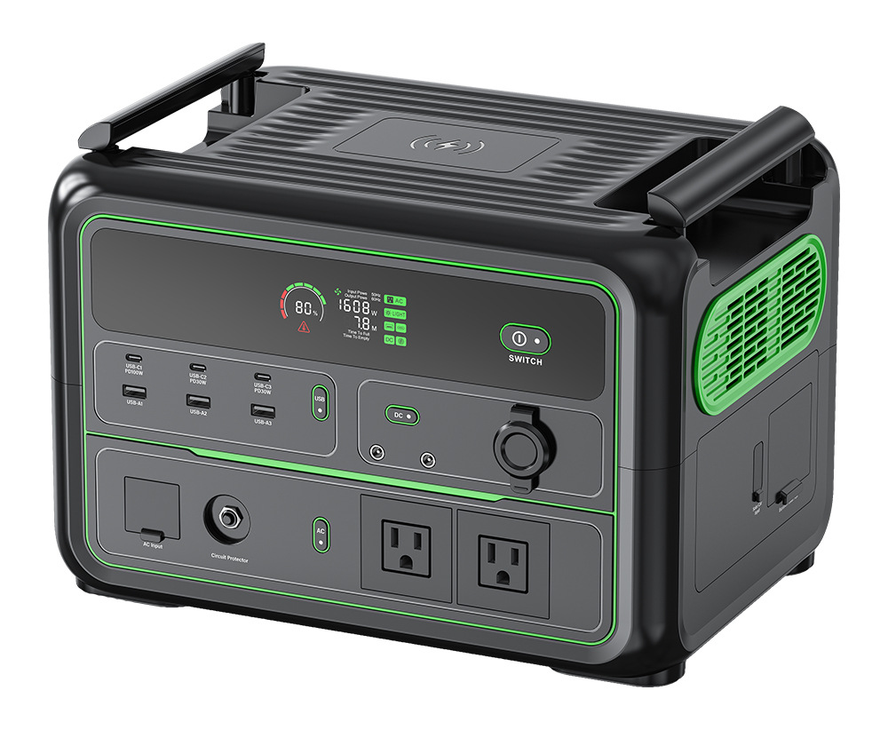
600W / 1200W Series:
All-round Mainstay, Handling Tasks With Ease
600W Series (AL600)
1200W Series (AL1200 / AL1200W)
Capacity: 336Wh
Rated Power: 600W (Peak 1200W)
Weight: ≈5kg
Features: Pure sine wave, 160W MAX input, PD 100W interface, meeting the needs of more devices.
Capacity: 1008Wh
Rated Power: 1200W (Peak 2400W)
Weight: ≈12kg
Features: Pure sine wave, 800W MAX input, supports wireless charging, ideal for home camping and emergency use.

Slide 16
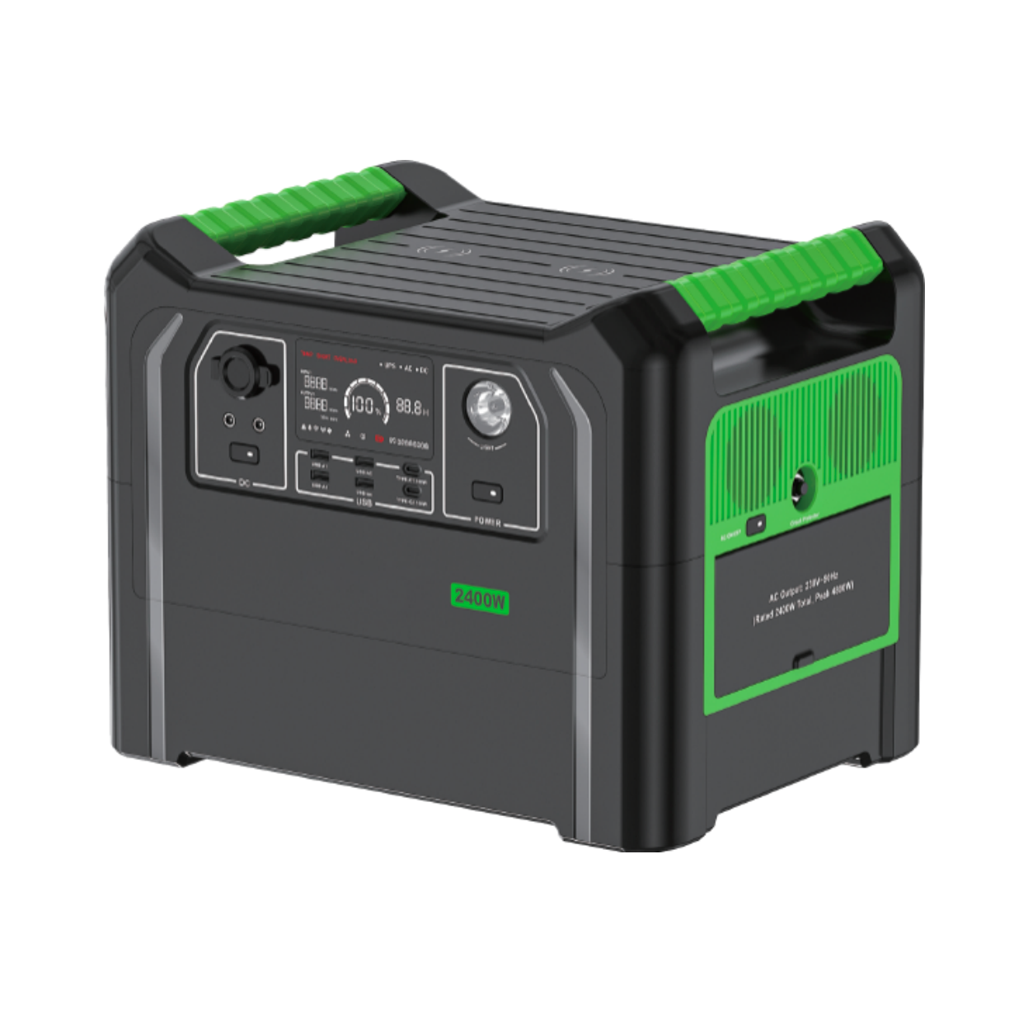
2400W Series:
Professional Flagship, Ultimate Challenge
Series positioning: Designed for the most demanding professional scenarios. Ultra-large capacity and ultra-high power meet the extreme power needs of RV travel, outdoor operations, large-scale activities, etc.
AL2400 / AL2400W
• Capacity: 2304Wh
• Rated Power: 2400W (Peak 4800W)
• Weight: ≈23kg
Key Selling Points:
• Powerful Performance: Can power high-powered devices such as air conditioners and electric ovens.
• Large Capacity: Sufficient power for several days of emergency household use or large events.
• Fast Charging: 1500W AC input, fully charged in approximately 1.8 hours.

Slide 17
04
APPLICATIONS
Boundless Electricity, Infinite Possibilities

Slide 18




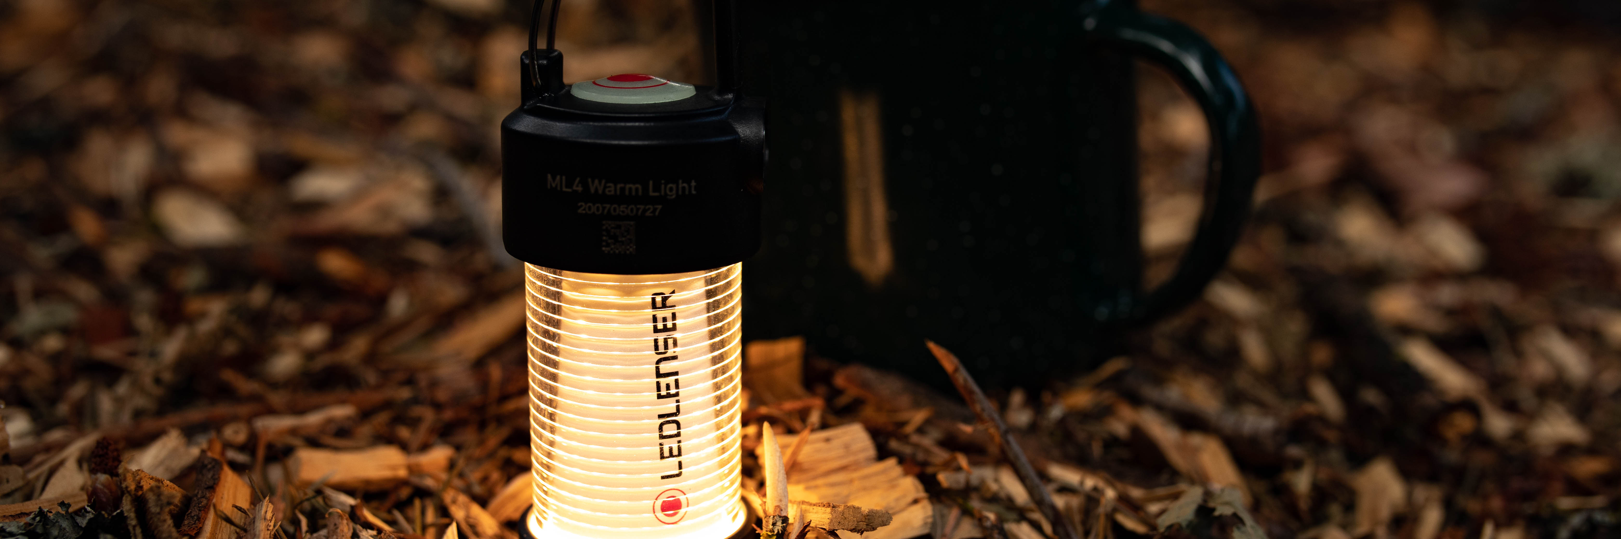

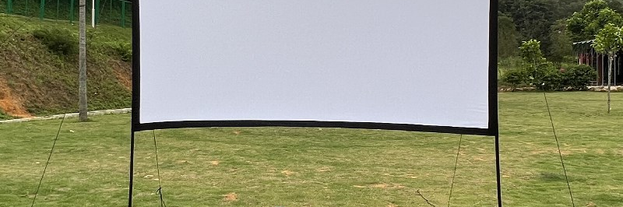
Outdoor Adventure
Say goodbye to campfires and candles, and usher in a new era of "comfortable camping" with BIBOO. Whether watching the sunrise from a mountaintop or stargazing at the seaside, BIBOO provides you with a continuous supply of power, making outdoor life as convenient as home.
Light up the campsite, create a warm atmosphere
Easily drive LED string lights and retro camping lights to create a warm glow for tents and picnic areas as night falls, instantly enhancing the camping atmosphere.
Enjoy hot food while cooking outdoors.
With a stable electric cooker, portable coffee maker, and mini oven, you can easily make coffee, hot soup, and light meals even in the mountains and fields, bidding farewell to cold dry food and embracing steaming hot outdoor cuisine.
Audio-visual entertainment, open-air parties
Provide continuous power to the projector and Bluetooth speaker, creating your own open-air cinema under the stars, playing classic films or cheerful music, filling your camping night with laughter.
Power supply ensures, keeping your moments alive.
Multiple interfaces can simultaneously power cameras, drones, and action cameras, ensuring that outdoor shooting, communication, and navigation equipment are always online and that no precious footage is missed.

Slide 19
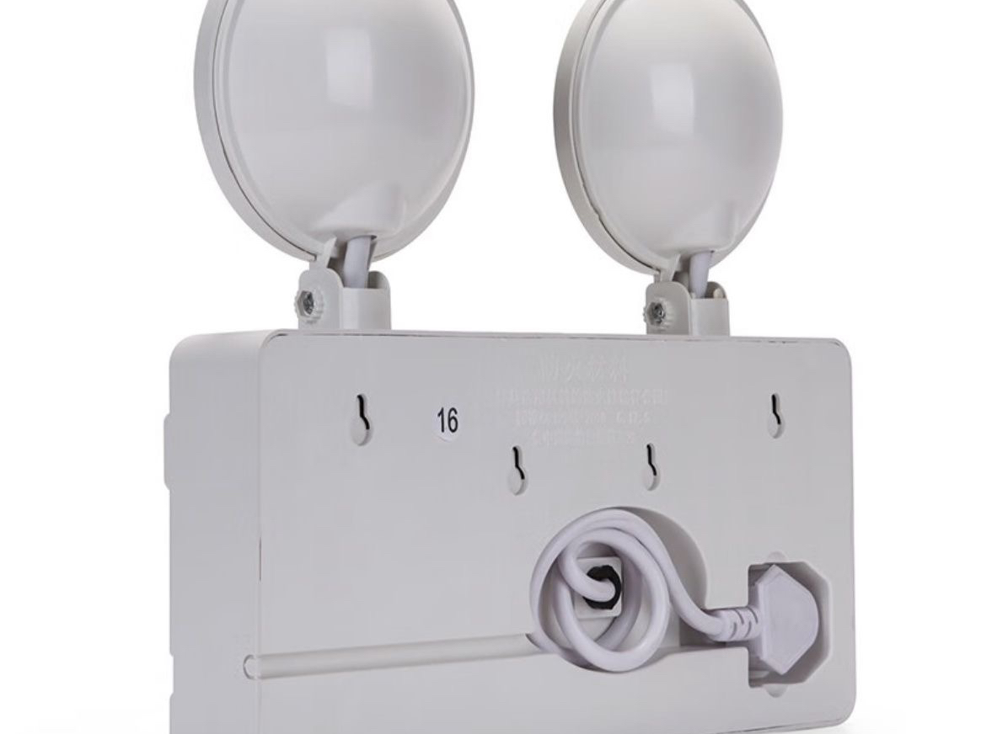



Home Emergency
In the event of a sudden power outage, BIBOO acts as a "backup heart" for your home. It activates instantly when the mains power fails, ensuring the basic functions of your household and the smooth flow of critical information, preventing unexpected events from disrupting your daily life.
Protect critical electrical appliances
Maintain ambient lighting
Continuously supply power to refrigerators and freezers to prevent fresh food from spoiling.
Turn on emergency lighting equipment to ensure the safety and convenience.
Maintain network communication
Critical medical support
Professional emergency lighting equipment, paired with the BIBOO power system, is plug-and-play, building a solid emergency protection line for your home and ensuring that power outages are no longer a problem in your life.
Provide continuous power to the optical modem and router to ensure uninterrupted communication in emergencies.
Providing power to critical medical equipment such as ventilators and oxygen concentrators to safeguard lives and health.

Slide 20
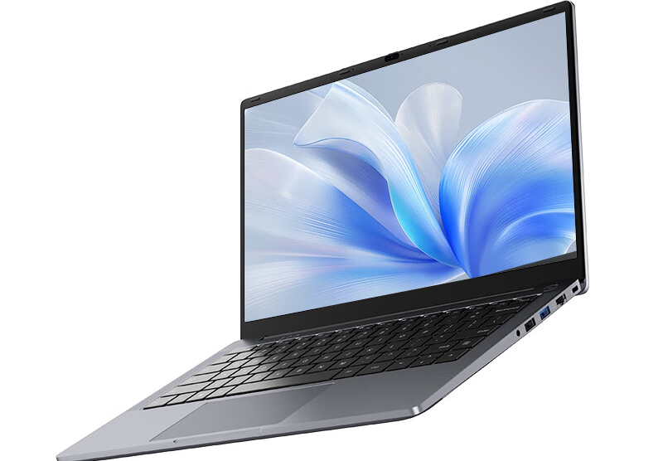



Mobile Office
Break free from the physical constraints of the office and start working efficiently anytime, anywhere. BIBOO provides stable, reliable, and long-lasting power support for all your work devices, making it the perfect partner for your professional work.
Continuous work
On-site survey
Outdoor live streaming
Uninterrupted power to core office equipment, like laptops, monitors, and printers.
It is compatible with surveying instruments, walkie-talkies, and tablets, ensuring accurate and efficient outdoor operations.
Provides long battery life for cameras, microphones, and fill lights, meeting the challenges of live streaming.
This lightweight power bank is perfectly suited for various office scenarios, freeing your creativity and work from the constraints of power outlets.

Slide 21
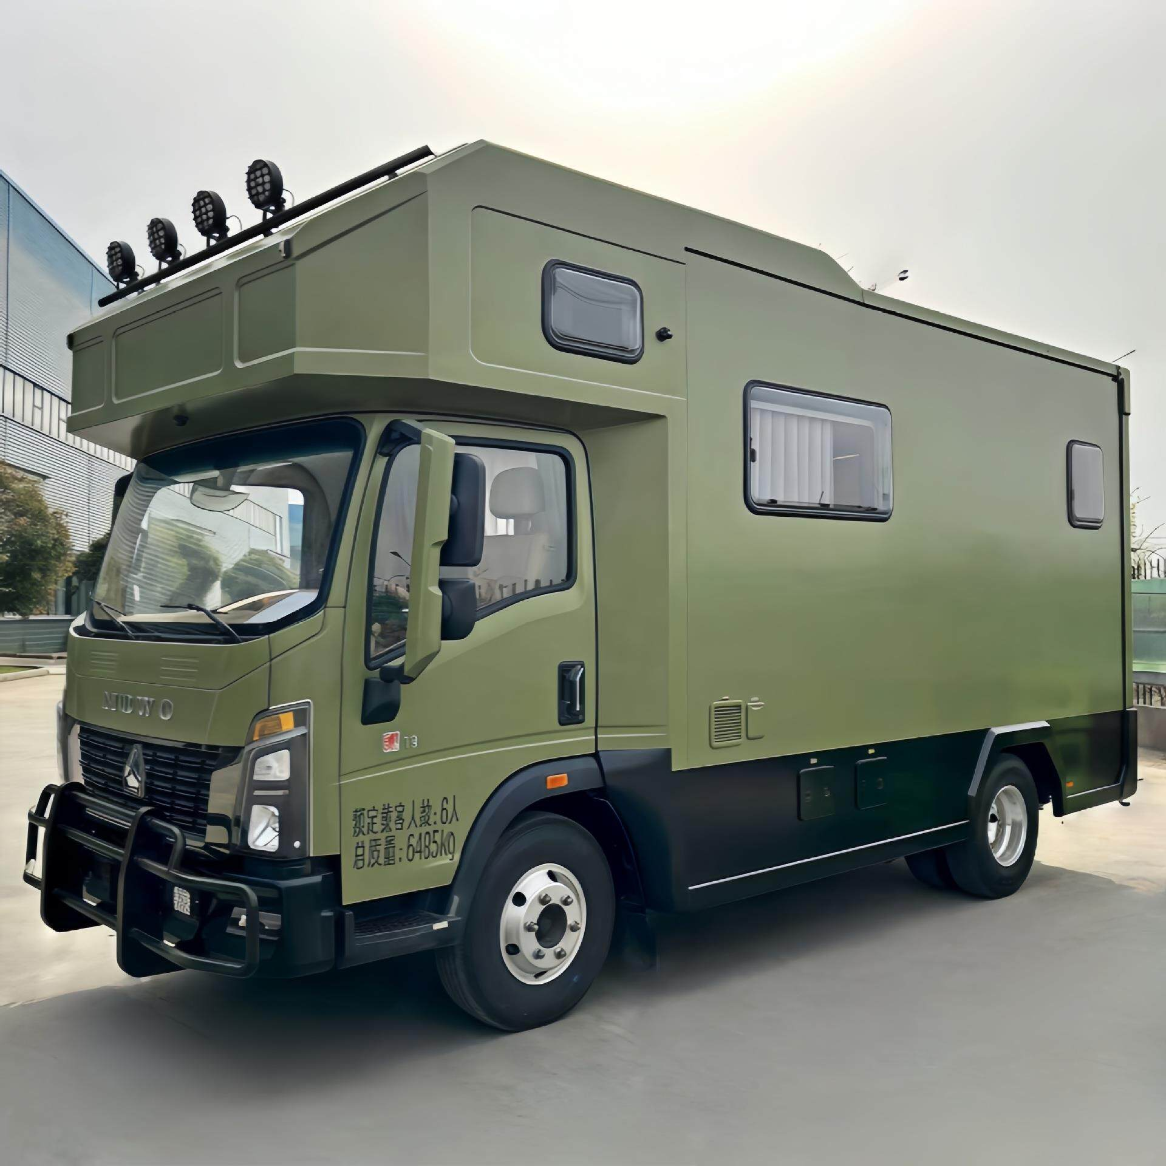



In-car Life
For RV enthusiasts and long-distance road trippers, BIBOO is a "power center" to enhance the quality of their journey, allowing you to enjoy the same power security and comfort as at home while traveling.
Expanding RV Power
Enrich in-car entertainment
Upgrade your life convenience
It supplements the shortcomings of the RV's built-in battery, meets the needs of long-term off-grid power use, and makes outdoor stays more comfortable.
Stable power supply for TVs, game consoles, and professional audio systems, making your travels more fun and exciting.
Easily operate microwave ovens, electric kettles, and mini washing machines, allowing you to enjoy convenient home life even while traveling.

Slide 22
05
ECOSYSTEM
Expanding Your Energy Boundaries

Slide 23
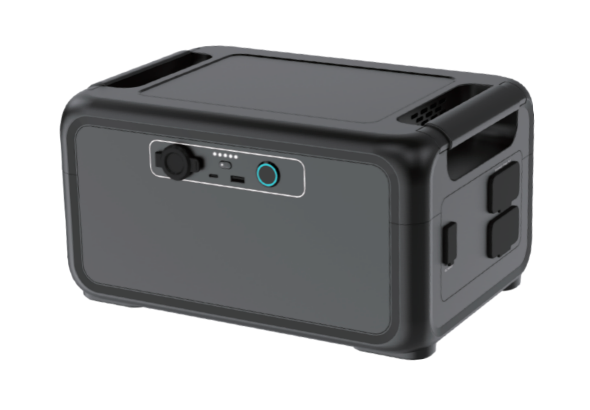


Expand Your Energy Boundaries
BIBOO Portable Solar Panels
BIBOO Smart APP Management
Extra Battery
Equipped with high-efficiency monocrystalline solar cells, it can be charged using clean energy at any time. It features an IP68 waterproof and dustproof design and a lightweight body.
The dedicated app puts the power supply in your palm, supporting real-time monitoring of remaining power, remote control of output ports, and setting timed power on/off.
Capacity: 1008Wh
Features: Extended capacity for compatible models, LiFePO₄ battery, supports 100W USB-C output, can be used as a standalone power source.

Slide 24

POWER YOUR OUTDOOR LIFE
Start your boundless journey now
Shenzhen Biboo New Energy Technology Co., Ltd.
Web
www.biboopower.com
Email
sales@biboopower.com
howson@biboopower.com
WhatsApp / Phone
+86-133-1296-5201

